Slide 1

TECHNO ENGINEERING COLLEGE BANIPUR
TITLE: TECB SPORTS MANIA
(TECB SPORTS MANAGEMENT SYSTEM)
DEPARTMENT- COMPUTER SCIENCE & ENGINEERING
4TH YEAR, 8TH SEMESTER
Guidance By-
Prof. Sulekha Das (Mentor)
Presented By
Payel Ghosh(24400121068)
Dibiya Sarkar. (24400121071)
Subha Roy. (24400121070)

Slide 2
INDEX
INTRODUCTION
ANALYSIS
HARDWARE AND SOFTWARE
KEY FEATURES
DATA FLOW DIAGRAM
FUTURE PLAN
OUTCOMES OF THE PROJECT
CONCLUSION
REFERENCES

Slide 3
INTRODUCTION
TECB SPORTS MANIA is an innovative web-based platform developed specifically for Techno Engineering College Banipur (TECB) to revolutionize the management of college sports events. This comprehensive solution offers a range of features aimed at simplifying the organization of sports events, managing participant registrations, and enhancing overall engagement. From intuitive event registration processes to efficient participant data management and result tracking, TECB SPORTS MANIA streamlines every aspect of sports management.

Slide 4
ANALYSIS
Data analysis
User analysis
Feasibility study
Functional Requirements Analysis
Risk Analysis

Slide 5
HARDWARE & SOFTWARE
Os- windows 11,Ram 8 GB SSD- 512GB card
It will be designed using HTML-CSS and JAVASCRIPT for front-end development and we are planning to use Node.js and Express.js in our backend development.
For creating the database, MySQL will be used to connect the database.

Slide 6
KEY FEATURES
User-Friendly Interface
Event Management
Participant Registration
Participant Management
Notifications and Updates

Slide 7
MODULES
Admin module
Add/Delete User
Add/Delete Activities
Student Module

Slide 8
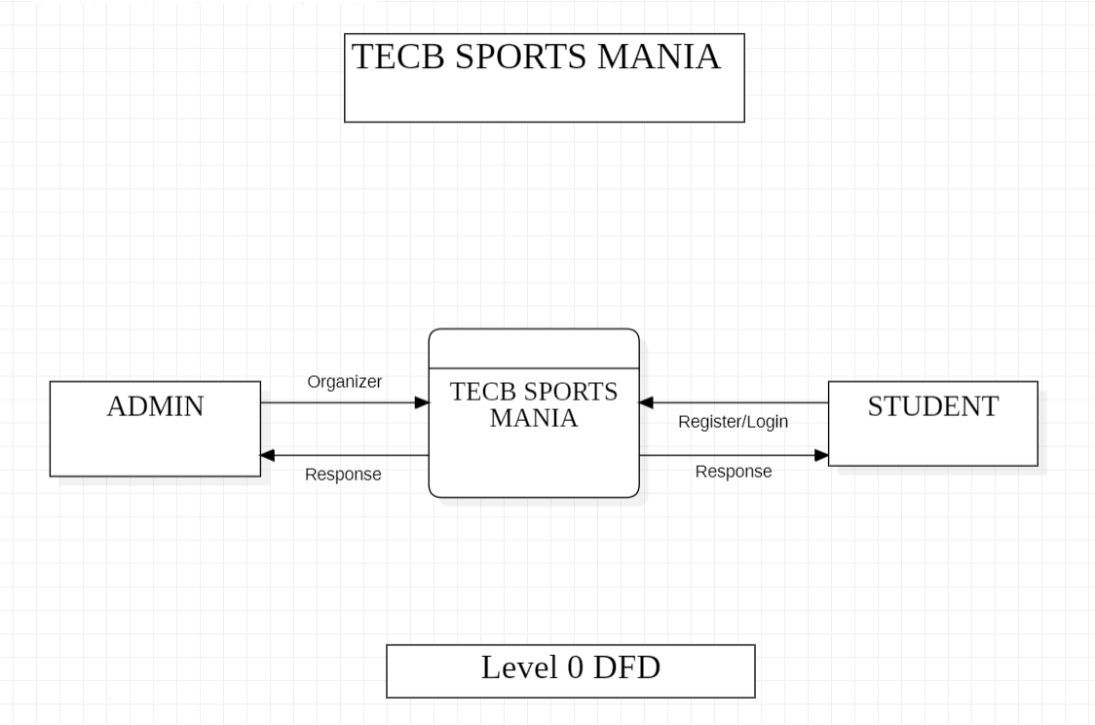
DATA FLOW DIAGRAM
LEBEL 0 DFD:

Slide 9
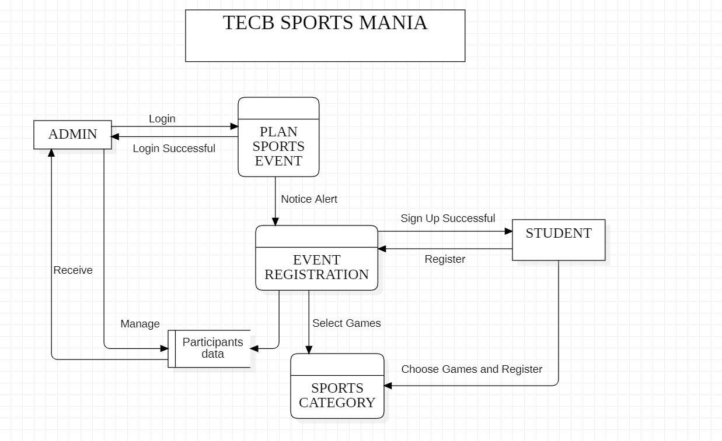
DATA FLOW DIAGRAM
LEBEL 1 DFD:

Slide 10
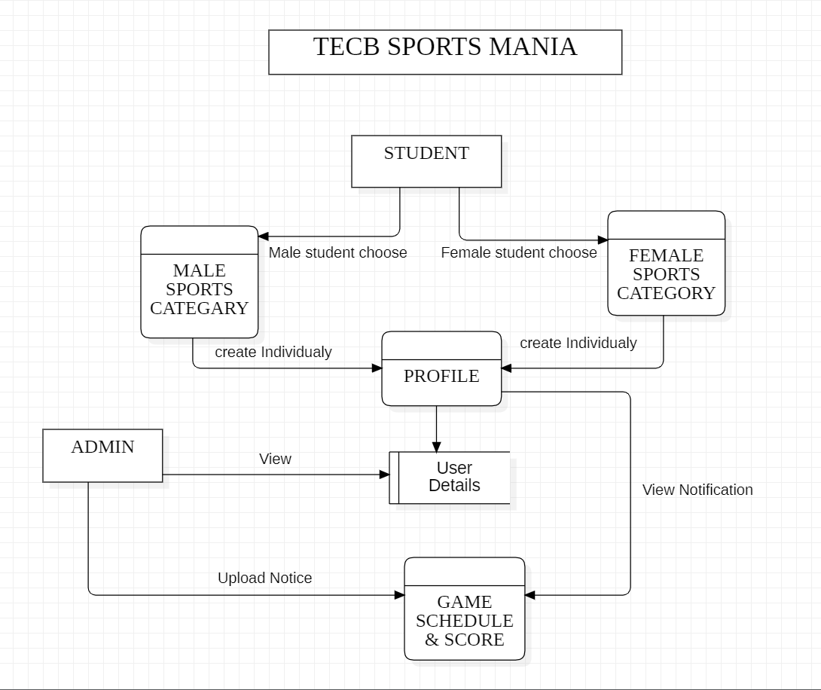
DATA FLOW DIAGRAM
LEBEL 2 DFD:

Slide 11
FUTURE PLAN
Mobile Application Development
User Feedback and Rating System
Community & Alumni Engagement
Tracking System

Slide 12
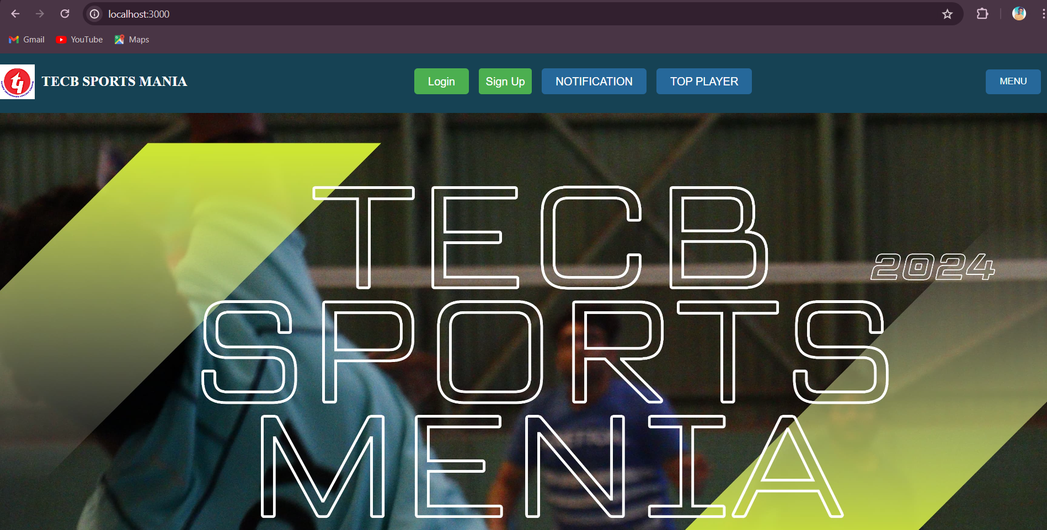
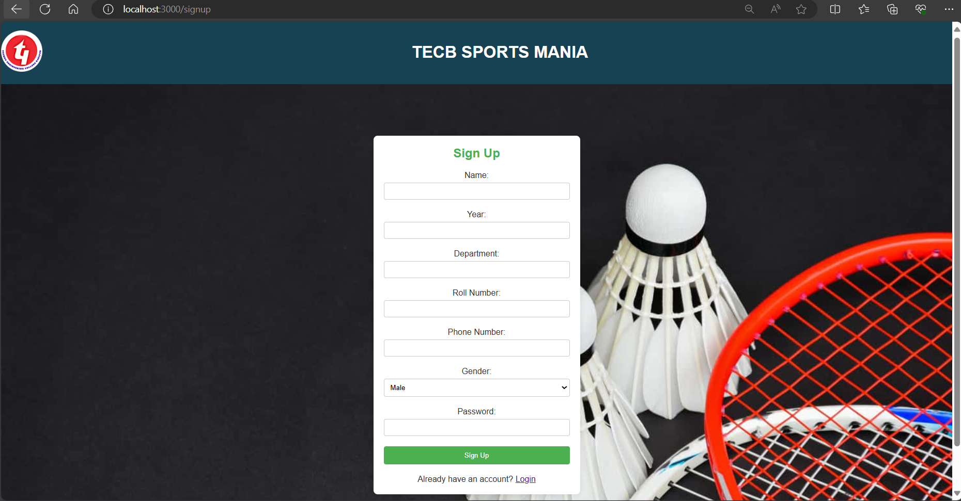
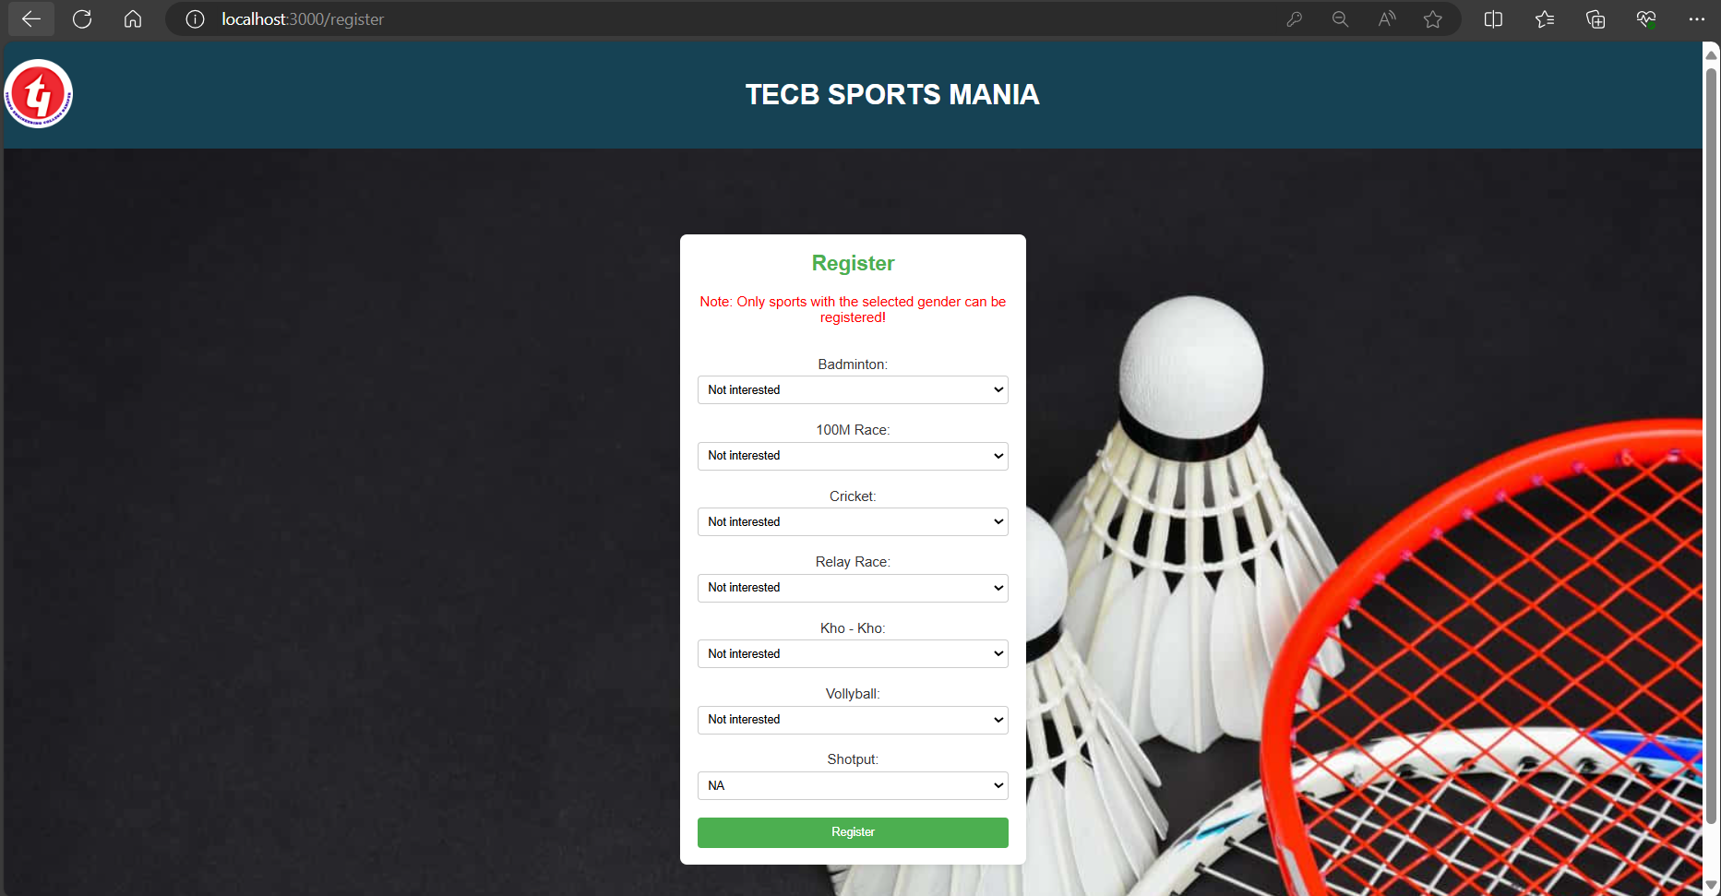
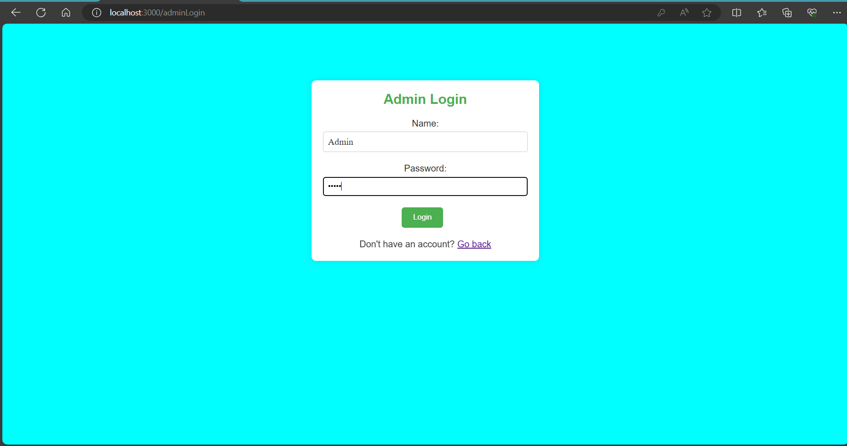
OUTCOMES OF THE PROJECT

Slide 13
CONCLUSION
The TECB Sports Mania project revolutionizes college sports
management by providing a user-friendly, centralized platform.
Leveraging modern web technologies and a robust backend, it
streamlines event organization, participant registration, and data
management. With real-time updates, secure data handling, and a
scalable architecture, it enhances efficiency and engagement. Its
successful implementation paves the way for future
enhancements, positioning it as a cutting-edge solution in the
sports community.

Slide 14
REFERENCES
https://github.com/
https://chat.openai.com/
https://stackoverflow.com/
https://www.udacity.com/
https://www.coursera.org/
https://www.edx.org/
https://www.youtube.com/
https://dev.mysql.com/doc/

Slide 15
THANK YOU

